Slide 1
Introduction to Reactive Extensions (Rx)
Training on Reactive Extensions for .NET (Rx .Net)
Internal Training Material

Slide 2
Agenda
A Little Bit of Context
Defining Reactive Extensions (Rx)
First Demo – Imperative vs Declarative
Rx and Observer Pattern
Brief Discussion about Concurrency and Threading
Second Demo – Some Operators and Concurrency
Simple Creation of Observables
Combining Observables
Third Demo – Combining Observables
Some Reference Material
Final Demo – Practicing and Testing Rx
Notes:
During the training first part, the goal is to demo Rx only.
On the second part (Final Demo) we’ll introduce the concept of ReactiveProperty and its usage in MVVM.

Slide 3
A Little Bit of Context
Reactive Programming is a declarative programming paradigm concerned with data streams and the propagation of change.
Based on https://en.wikipedia.org/wiki/Reactive_programming

Slide 4
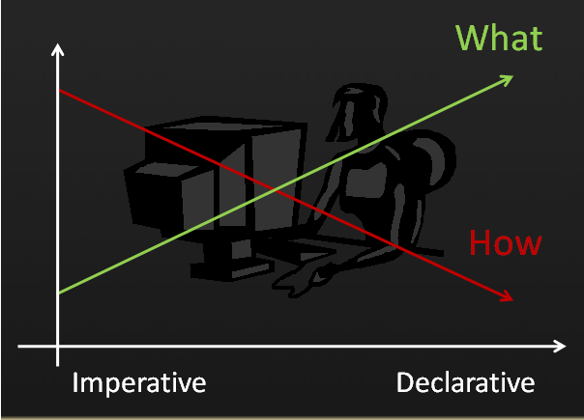
A Little Bit of Context
“(…) declarative programming paradigm (…)”
Imperative Paradigm vs Declarative Paradigm
Imperative Paradigm: How I want it done
Declarative Paradigm: What I want done

Slide 5
A Little Bit of Context
“(…) declarative programming paradigm (…)”
Imperative
Declarative
var sum = 0;
for(int i = 0; i < 10; i++)
{
sum += items[i];
}
var sum = items
.Take(10)
.Sum();

Slide 6
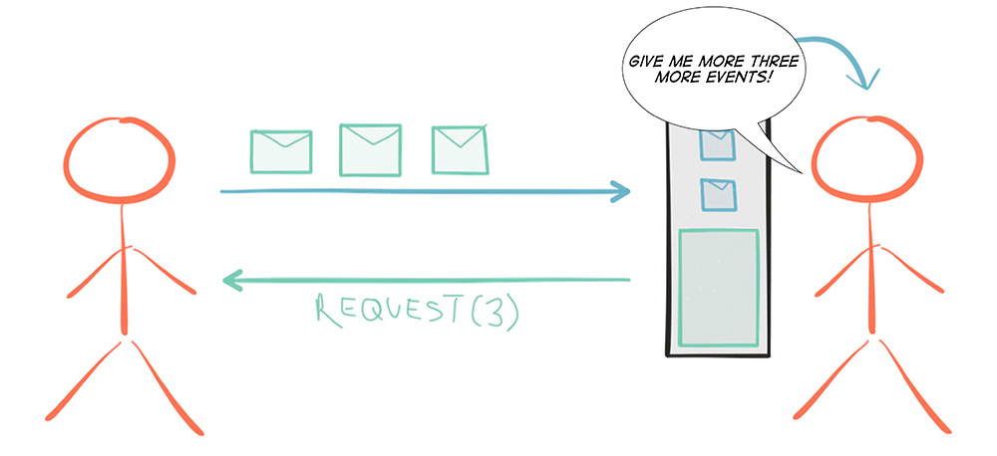
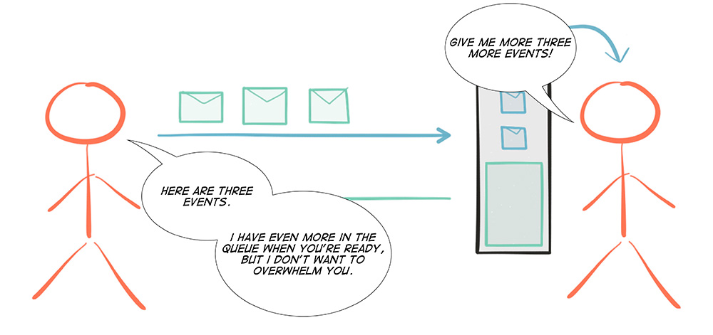
A Little Bit of Context
“(…) propagation of change (…)”
Pull Model vs Push Model
Pull Model: The consumer requests data from the source
Push Model: The source notifies the consumer with data events

Slide 7
A Little Bit of Context
“(…) propagation of change (…)”
Pull Model
In imperative programming, the application actively polls a data source for more information by pulling data from a sequence that represents the source.
The application is active in the data retrieval process. It also controls the pace of the retrieval by pulling data at its own convenience.

Slide 8
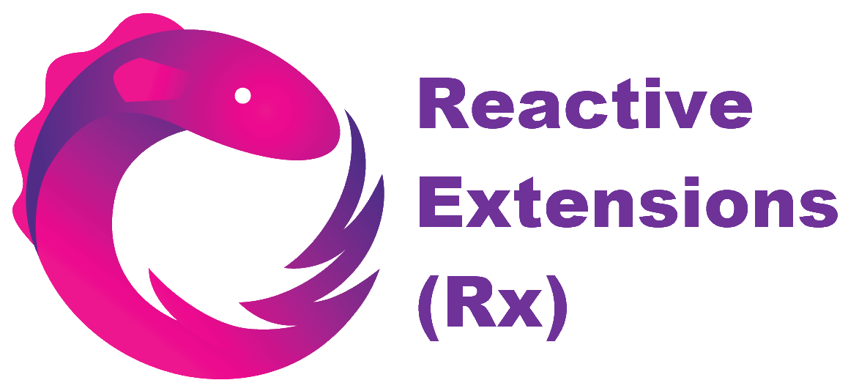
A Little Bit of Context
“(…) declarative programming paradigm (…)”
“(…) data streams and the propagation of change.”
Push Model
The application is offered more information by subscribing to a data stream and any update is handed to it from the source.
The application is passive in the data retrieval process: apart from subscribing to the observable source, it does not actively poll the source, but merely react to the data being pushed to it. When the stream has no more data to offer, or when it errors, the source will send a notice to the subscriber.

Slide 9
Defining Reactive Extensions (Rx)
Reactive Extensions (Rx) is a library for composing asynchronous and event-based programs using observable sequences and LINQ-style query operators.

Slide 10
Defining Reactive Extensions (Rx)
Data sequences can take many forms, such as a stream of data from a file or web service, web services requests, system notifications, or a series of events such as user input.
Reactive Extensions represents all these data sequences as observable sequences. An application can subscribe to these observable sequences to receive asynchronous notifications as new data arrive.

Slide 11
Reactive Extensions (Rx)
First Demo – Imperative vs Declarative

Slide 12
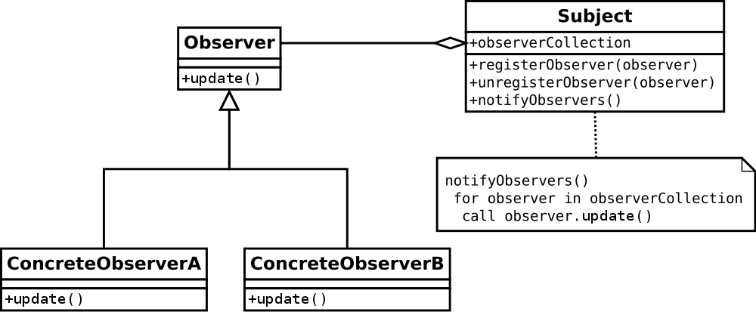
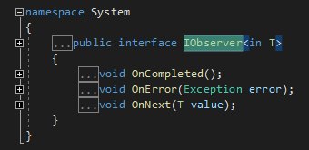
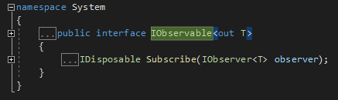
Rx and Observer Pattern

Slide 13
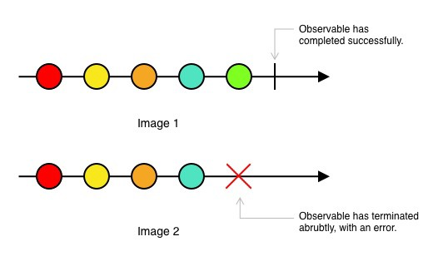
Rx and Observer Pattern
Marble Diagrams

Slide 14
Brief Discussion about Concurrency and Threading
Schedulers
In the Rx world, there are generally two things you want to control the concurrency model for:
The invocation of the subscription
The observing of notifications
Rx provides SubscribeOn() and ObserveOn() on IObservable in order to take full control of the concurrency model.

Slide 15
Reactive Extensions (Rx)
Second Demo – Some Operators and Concurrency
Notes:
Explain the change to the tuple;
Remove comment on SubscribeOn() and ObserveOn() to run on other threads;
Uncomment the source code to prove some points;

Slide 16
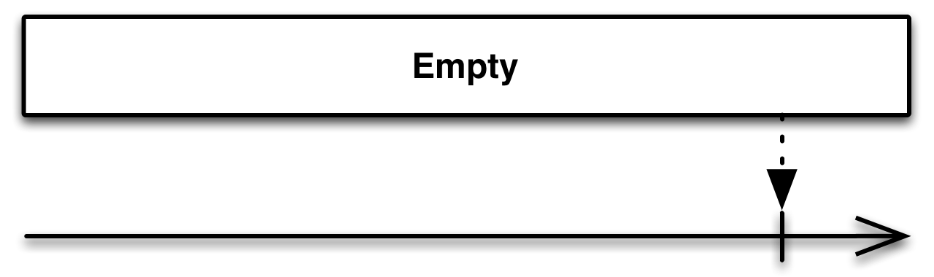
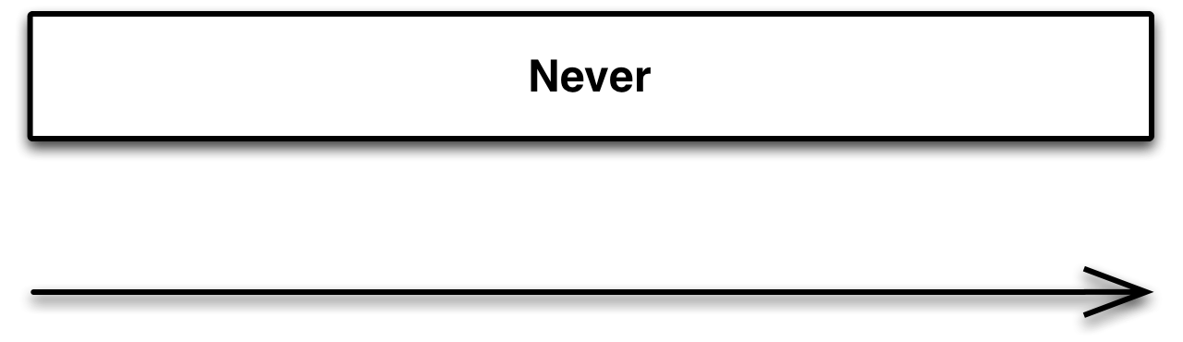
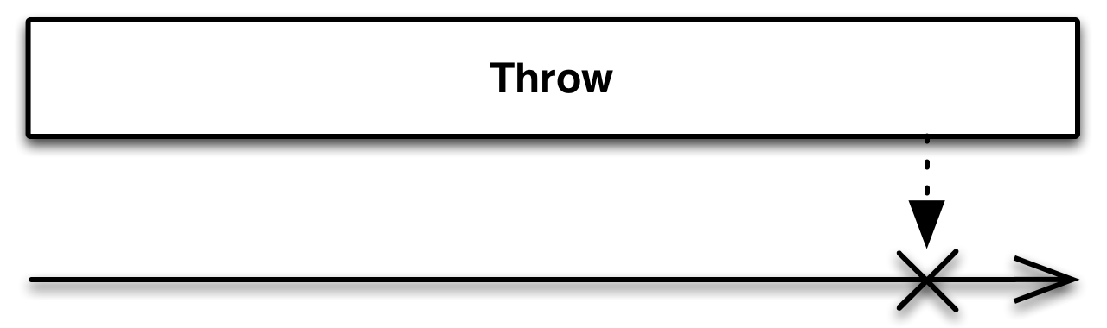
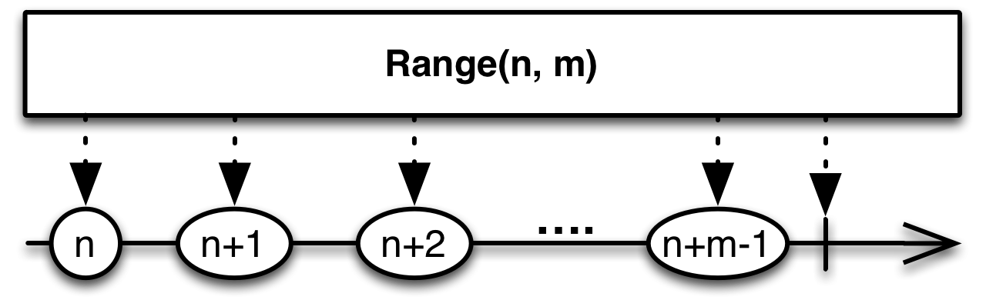
Simple Creation of Observables
There is a generous number of operators that creates Observables.
Creates an Observable that emits no items but terminates normally
Creates an Observable that emits no items and does not terminate
Creates an Observable that emits no items and terminates with an error
Creates an Observable that emits a particular range of sequential integers

Slide 17
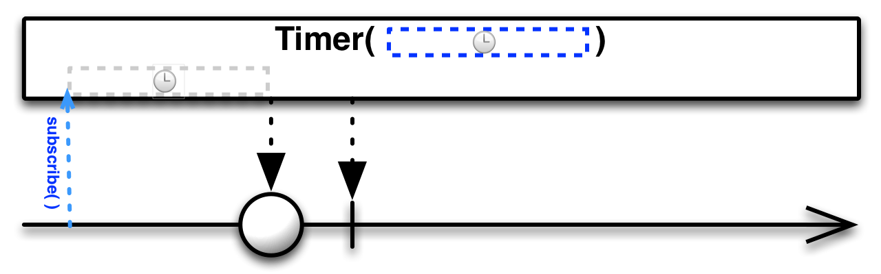
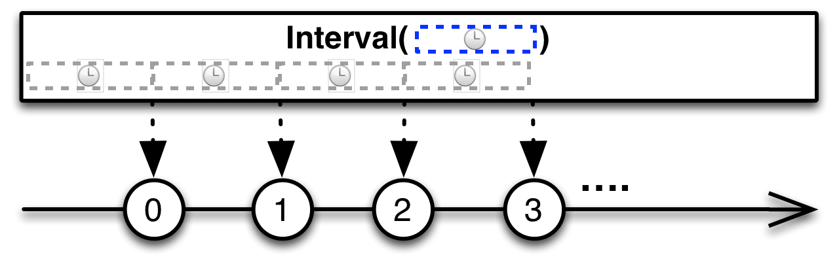
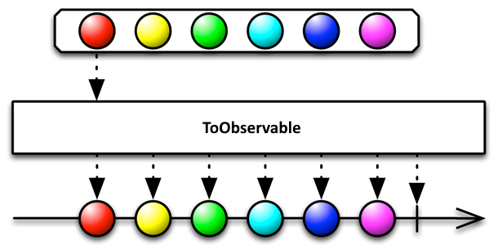
Simple Creation of Observables
Creates an Observable that emits a particular item after a given delay
Creates an Observable that emits a sequence of integers spaced by a given time interval
Converts various other objects and data types into Observables

Slide 18
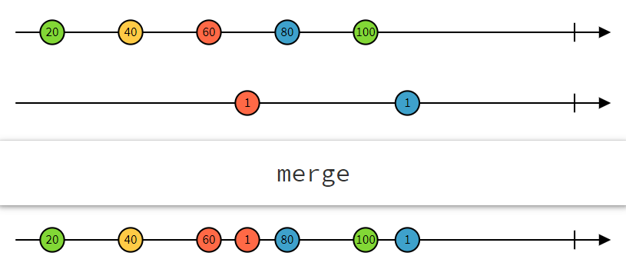
Combining Observables
In real scenario applications it’s usual to manage more than one stream of data.
Most of the times, we need to combine two streams. This is accomplished by applying an operator that transforms these two sequences into a single one.
Example: Combine 2 observables with Merge operator

Slide 19
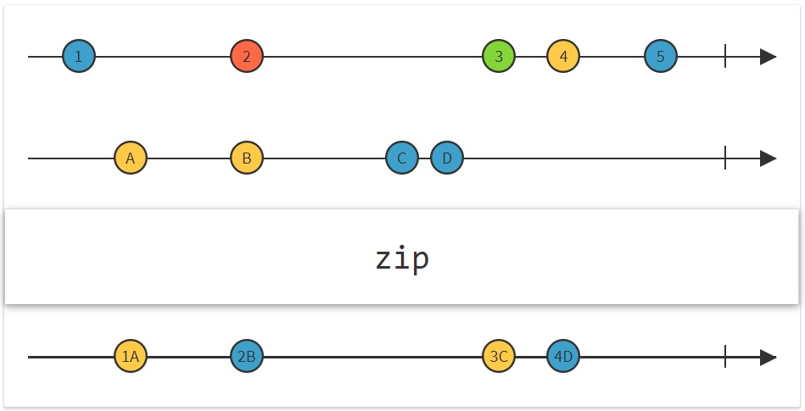
Combining Observables
Zip
Combines the emissions of multiple Observables together via a specified function and emit single items for each combination based on the results of this function.

Slide 20
Reactive Extensions (Rx)
Third Demo – Combining Observables

Slide 21
Some Reference Material
http://reactivex.io/
http://introtorx.com/
https://scotch.io/tutorials/rxjs-operators-for-dummies-forkjoin-zip-combinelatest-withlatestfrom
(Really cool animated tutorials)
https://rxmarbles.com
(Some nice interaction Marble Diagrams)

Slide 22
Reactive Extensions (Rx)
Final Demo – Practicing and Testing Rx

